Slide 1

Service Performance Management
ISO27001 – Project Management Training

Slide 2

Introduction
This training session is focused on providing a high-level overview of ISO27001, and how this has been designed to support Aggreko Technology Services.
This will focus on providing an overview on the development, planning and execution of the Information Security Management System (ISMS) related to Project Management.
This training will reference Legislation, Policies, Standards and Standard Operating procedures, which will support Information Security Management System objectives from Project Management.

Slide 3
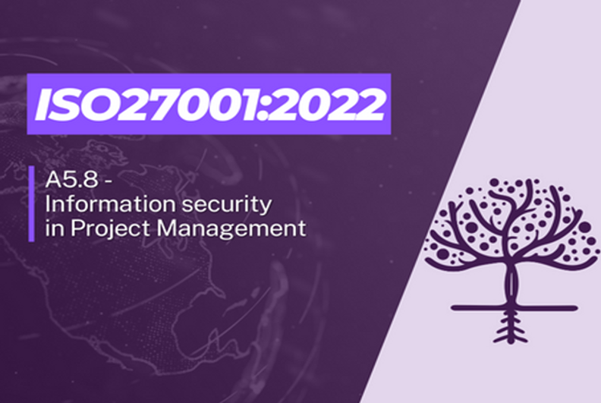
Agenda and Objectives
Agenda
ISO27001 Overview, structure and Framework
Aggreko ISO27001 Scope & Design
Aggreko ISO27001 – Project Processes & Documentation Stages
Security Requirements for RFP’s
Architecture and Security Assessment
Stakeholder Management
Risk Management
Key Standards and Policies
Roles & Responsibilities
Project Security Closure Checklist
Objectives
Provide a high-level overview of how the ISO27001 Framework has been designed for ATS.
Create awareness and communicate the structure of ISO27001.
Supplement the training delivered for the policies and standards.
Provide an opportunity to ask questions.

Slide 4
Introduction to ISO27001
What is ISO27001
ISO 27001 is the international standard for Information Security and sets out a framework for all organisations to establish, implement, operate, monitor, review, maintain and continually improve an ISMS (Information Security Management System).
The standard is recognised worldwide as proof that an organisation’s information security management is aligned with best practice.
This framework’s purpose is to protect companies’ information in a systematic and cost-effective way, regardless of their size or industry.
Core Principles: Availability, Integrity & Confidentiality
Key Benefits
Compliance with legal requirements – provides a methodology for information security policies to support such as GDPR
Competitive advantage – supports wining customer contracts by assuring we keep their information security safe
Lower costs – supports the prevention of security incidents by implementing best practice standards
Better organisation – encourages companies to write down main processes to support Information Security
Did you know?
In 2017, due to vulnerabilities and unpatched systems, a company lost sensitive information for 147 million customers - costing 700M.
Findings showed the foundational elements of cyber and information security were not implemented and no processes were written. This could have been avoided using an Information Security Management System to implement best practice.

Slide 5
ISO27001 Framework
The ISO27001 Framework mandates that the Plan, Do, Check, Act cycle (PDCA) is used to create and develop the ISMS. The Management Clauses define the ‘groundwork’ for the system. This supports the development of controls, standards, operating procedures and then how we will continuously improvement to ensure a robust Information Security Management System. The diagram below demonstrates the key ‘Management Clauses’.
PDCA Application
Management Clauses
Managed Information Security System
Plan; Establish the ISMS
4: Context of the organisation
Identify the needs of stakeholders and clarify their needs and interests
Define the scope of the ISMS, including Exec Level
5: Leadership
Obtain commitment from leadership and establish policies
Define roles and responsibilities
6: Planning
Assess risks and vulnerabilities, as well as opportunities to improve information security
Do; Implement and Operate the ISMS
7: Support
Define and document resources for maintaining the ISMS
8: Operation
Define risk treatment plans and implement controls
Annex A Controls (94)
Organisation, People, Physical & Technological
Check; effectiveness
9: Performance evaluation
Monitor, measure and assess control effectiveness
Conduct internal audits and management reviews
Act; on improvements
10: Improvement
Identify nonconformities and corrective actions
Note: ATS Management clauses are detailed within the appendices.

Slide 6
Control Mapping
There are 93 Controls grouped into the following categories and the basis of the scope, risks, roles / responsibilities we have mapped out example control standards. Risks will be primarily generated from the Control Standards.
A.5 Organisational Controls
A.6 People Controls
A.7 Physical Controls
A.8 Technological Controls
Control Mapping Examples
Control Standard
Documentation / System
Organisational Control: Identity Management
Identity and Access Management – Global Policy / Standard
People Control: Information Security Awareness
Information Security Policy / Workday Training
Physical Control: Physical Entry Access
Physical Access Security Standard
Technical Control: Segregation of networks
IT Infrastructure Standard
Impact to operations
Control standards will apply to all ATS services. It should be noted however, we are already complying with these standards as part of various policies and procedures e.g. IAM. There may be system sampling to prove we adhere to these standards, but some controls may be removed as part of our Statement of Applicability.
Note: It is likely customer facing systems and infrastructure will be sampled for the purposes of certification and meeting control standards.

Slide 7


Compliance VS Conformance
Compliance and Conformance Requirements for ISO 27001 Accreditation
Compliance
Conformance
Adhering to laws, regulations, and contractual obligations related to information security.
Meeting the requirements specified in ISO 27001 standard to achieve certification.
Data protection regulations
Crypto-sharing
Retention
CyberEssentials+
Non-disclosure
Implement the ISMS
Policies, Standards, Procedures
Risk management
Access Controls
Audit
Non-Conformities
A non-conformity is a failure to adhere to legal requirements, policies and / or standard. Projects are expected to ensure that these are adhered to within the remit of the project. Various processes should support this e.g. RFP’s / Security Assessments
A non-conformance may or may not be a risk to Aggreko and must be raised within the Information Security Risk SharePoint
Notes:
During this section, we're going to discuss a critical aspect of our journey towards ISO 27001 accreditation: understanding the difference between Compliance and Conformance, and the responsibilities that come with it.
Compliance refers to our adherence to laws, regulations, and contractual obligations that are directly related to information security. This includes areas like data protection regulations, retention policies, and CyberEssentials+ certifications, among others. Compliance is about ensuring that we meet external requirements and obligations that protect our organization and our customers.
On the other hand, Conformance is about aligning our internal practices with the specific requirements of the ISO 27001 standard. To achieve certification, we need to establish and maintain an Information Security Management System (ISMS), implement effective policies, manage risks, enforce access controls, and conduct regular audits among other activities.
As senior leaders, your responsibilities are twofold. Firstly, you must demonstrate commitment and leadership by actively supporting the implementation of the information security management system and by also driving continuous improvement in our security practices. Secondly, we need you to ensure resource allocation, which involves providing the necessary financial, personnel, and time resources to achieve and maintain our ISO 27001 certification.
In summary, while compliance ensures we meet external obligations, conformance ensures our internal systems and processes are robust and aligned with ISO 27001 standards. Both are crucial elements for our success in achieving and sustaining ISO 27001 accreditation.

Slide 8
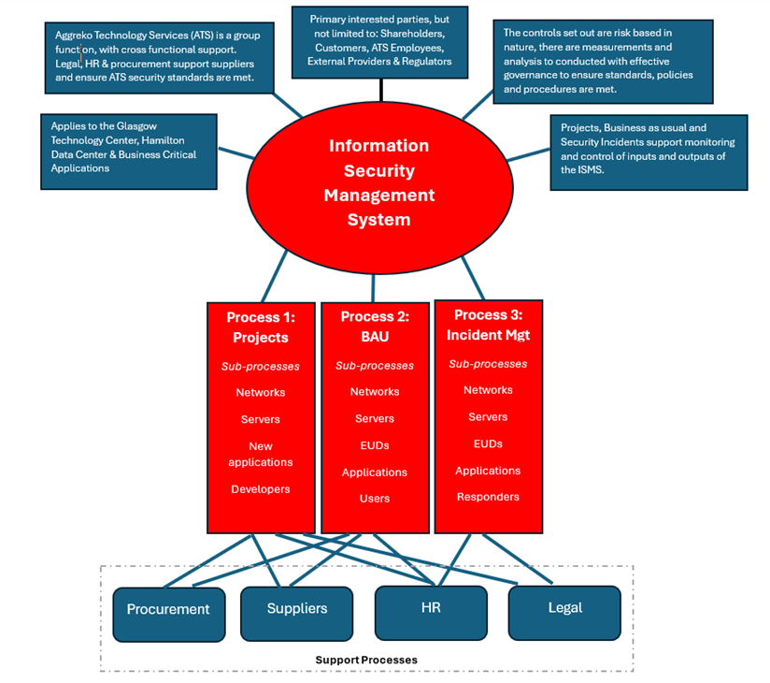
ISO27001 – ATS Scope and Design
ISO27001 – ATS Scope
"Information security and data assets supported and managed by the Glasgow ATS team for our critical business applications, ensuring the secure provision of mobile modular power, temperature control, and energy solutions.“
Boundaries of the Information Security Management System
The Information Security Management System will be implemented at the Glasgow Center, Hamilton Data Center sites and will apply to Cloud Services provided by 3rd parties. The Physical boundaries for our ISO Management System Standards is documented in the ISMS Risk Register. Support functions and associated business managed processes are excluded from the scope of the audit.
Rationale
Allows for a wide scope to ensure we meet the Minimum Viable Product for ISO27001.
Focuses on our data assets and information security for key business applications.
Note this covers infrastructure, networks and EUC.
Glasgow Center is our primary workforce site.
Hamilton Data Center is our primary Data Center

Slide 9

Questions

Slide 10
Aggreko ISO27001 – Project processes & documentation

Slide 11
Aggreko ISO27001 – Project processes & documentation
Continuous Service Improvement
ISO27001 – Project processes, documentation and standards.
Customer Requirements /
Initial Request
Customer Satisfaction
/ Live Service
Reject
Reject
Capture Customer / Service & Security Requirements
Request for new or changed service
Security assess
Approve
Procurement, Project Planning & Delivery.
Service Transition, Risk output & team engagement
Security assess
Approve
Documentation
Stakeholder Assessment / Business Case
Request for Purchase
(Security Requirements)
Service Requests
Architecture / Security & PIA Assessment & Initial Risk Register
Project Plan, Risk Register, Test Plans & Change (Security) Management
Service Transition –Governance, IAM, Change, Security Incidents / Alerts, Service Catalogue, Runbooks & knowledge
Final security assessment, Project Closure (Security Checklist) . Lessons Learned
– Go / No Go
Risk Management /
Non-Conformity Output
ISO Standards
Management Clause – Stakeholders & Other interested parties
Third Party Standards / Information Security Policy
All relevant standards e.g. Risk Management Standard
Global Access & Identity Management Policy
All relevant standards e.g. IT Infrastructure and Continuous Improvement
Risk Management Standard / Information Handling Standard
11

Slide 12
Stakeholder & Other Interested parties - Analysis
As part of our Management Clause (4.2 ISMS – Stakeholders and other interested parties) we are required to ensure that stakeholders and other interested parties that are relevant to Aggreko’s purpose, strategic direction and Information Security issues are identified, their relevant requirements determined, and these are considered when establishing and maintaining the Information Security Management System.
The process of identifying stakeholders and other interested parties, their expectations and success measures is called stakeholder analysis and should be conducted after establishing the vision and mission of Aggreko.
For Project Management, we are interested in the following:
A project planning template for identifying the stakeholders and determining their power, influence, and interest to work out how to win their support for a particular project. This has been created and developed by our Business Analyst team.
The first is created when developing the strategic plan and identifying the business processes to implement it, and the second during the execution of the plan as an aid to managing the relationships between various stakeholders effectively.
We will then output this into a stakeholder map, which has been used to identify the stakeholders and other interested parties.
Stakeholder Analysis Workshop with template:
12

Slide 13
Aggreko ISO27001 – RFP Requirements
The RFP requirements should help to identify any initial project risks, these should be surfaced as part of the Architecture / Security Review and entered into the Security Risk Register.
Requirement serial number | Requirement name | Requirement Description
 |  | Security requirements
6.1.1 | Data Security | Where are your data centers located?
6.1.2 | Data Security | Are the data centers managed and supported by your company or provided by an outsourced entity?
6.1.3 | Data Security | Are data centers ISO27001 Compliant and Certified?
6.1.4 | Data Security | What are the exact locations including the country of all locations where Aggreko data is (will be) transferred to, stored, processed or handled?
6.1.5 | Data Security | What other 3rd Parties or Suppliers are granted access to Aggreko data or systems? If there are any please detail the due diligence performed over their Information Security control environment.
6.1.6 | Data Security | How is access to Aggreko data restricted to only authorized users?
6.1.7 | Data Security | How is Aggreko data segregated from other organizations data if applicable?
6.1.8 | Data Security | How is the principle of least privilege applied when accessing Aggreko data?
6.1.9 | Data Security | Please explain the controls in place to ensure the confidentiality and integrity of Aggreko data at rest, for example encryption and logging.
 | Data Security | Please explain the controls in place to ensure the confidentiality and integrity of Aggreko data in transit, for example end-to-end encryption.
6.1.10 | Data Security | Please explain the controls to ensure secure deletion and/or disposal of all media both electronic and physical.
6.2.1 | Information Security Management & Governance | Are you ISO 27001 accredited? What part of your business holds it? When did you first become accredited and when was your accreditation last renewed?
6.2.2 | Information Security Management & Governance | Do you hold any other Information Security related accreditation?
6.2.3 | Information Security Management & Governance | What steps have been taken to ensure the organization is compliant with applicable Privacy / data Protection Laws.
6.2.4 | Information Security Management & Governance | What steps have been taken to ensure the organization is compliant with EU GDPR?
6.3.1 | Security Policy | How are Information Security policies and standards conveyed to the organization, its employees and contractors?
13
ISO27001 RFP Requirements:

Slide 14
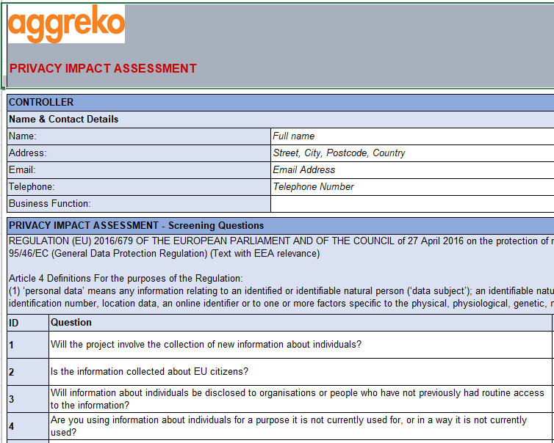
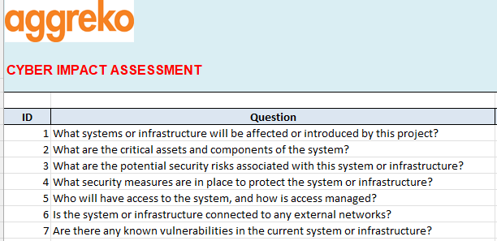
Aggreko ISO27001 – Security / Architecture Assessment
The architecture and security teams have created the following template to satisfy the requirements of the standard. They will review various elements such as cryptography and IT infrastructure standards to ensure our requirements are met.
This is completed twice in the project lifecycle:
Initial Security Assessment – Based on supplier selection post the RFP. Any risks from the RFP / Initial Assessment should be tracked.
A Privacy impact Assessment and Security Assessment should be complete at this stage – any risks & non-conformities should be raised.
Final Security Assessment / Project Closure – Any outstanding risks from the project or identified security issues should be raised on the Information Security SharePoint.
During project delivery new risks may be identified and any changes (including security) should be raised to support security / architectural assessments.
ISO27001 Privacy Impact Assessment
ISO27001 Security Impact Assessment

Slide 15
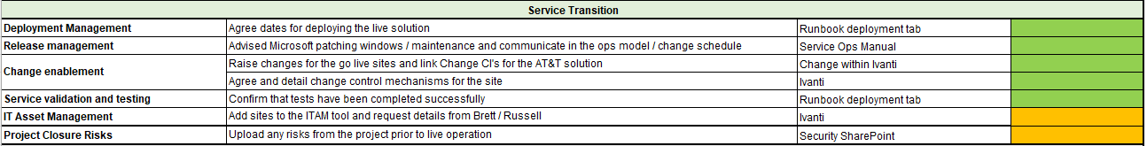
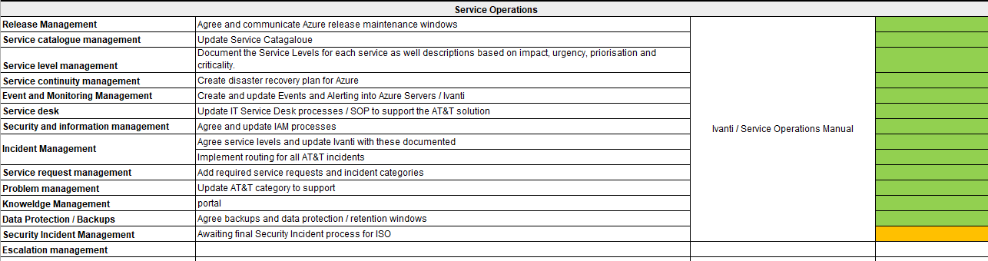
Aggreko ISO27001 – Project processes & documentation
As part of Service Transition, we should ensure that we have good practices in place to address the standards required of the ISO27001 framework, including but not limited: Supplier Cyber processes / Security Event and Incident Management, Access and Identity Management, Data Classification / Protection and Backups.
Sample transition plan (requires further enhancement):

Slide 16
Questions

Slide 17
Information Security Risk Management & Conformance

Slide 18
Information Security Risk Management
Information Security risk guidance is available :
IS Risk training video, available under ‘Procedures’ on the ISMS *link to ISMS in Appendix
IS risk governance documents available on the ISMS under the ‘operations’ section of the ISMS
Ask me after this session

Slide 19
IS Risk Appetite
The level of risk we are prepared to accept in pursuit of our goals
IS Risk Appetite and Tolerance Policy
Produced by our Chief Information Officer yearly
Is the cornerstone of all risk activities
Risk Appetite Statement
“ATS will adopt an approach to information security risk which is ‘Cautious’ - we prioritise the protection of our information assets over operational convenience and efficiency. We recognise that cyber risk cannot be eliminated entirely and so maintain economic mitigation measures to protect our business”

Slide 20
What Will Be Provided To Risk Owners
IS guidance for risk owners
IS Risk Reporting Guide
IS Risk Management Training Video
Risk Owner Guide to Risk Register Entry
Risk Treatment Plan Template
Risk assessment information
Risk treatment recommendation
Free risk consultation with yours truly

Slide 21
What Risk Owners Will Need To Produce
Raise non-compliances and risks in your area, and report them to IS
Complete Risk Treatment Plan
Delegate or liaise to provide resources to treat risk
Carry out risk treatment
Report on risk treatment activities
Provide evidence

Slide 22

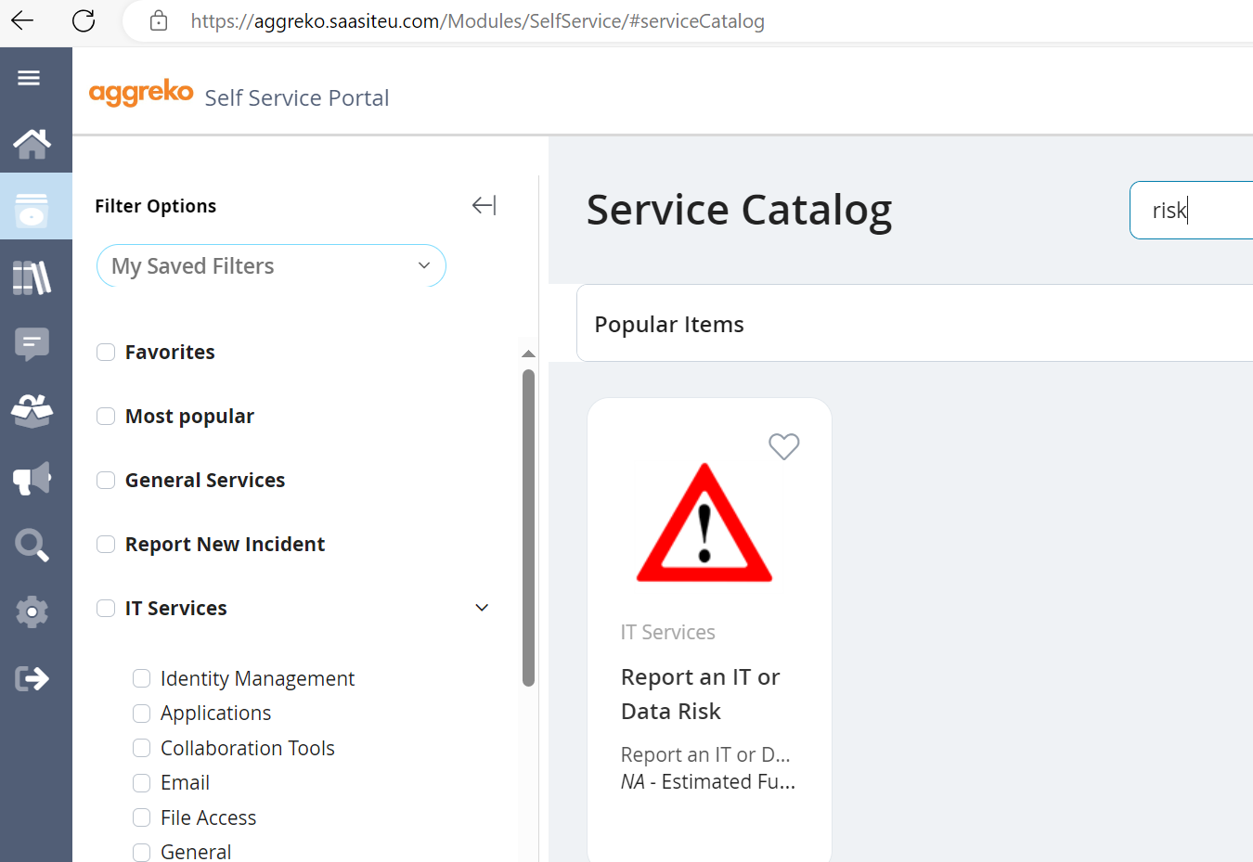
Report Information Security Risks Through the Aggreko self-service portal
How to Raise a Risk or Non-Compliance

Slide 23
Questions

Slide 24
Key Standards / Policies & Project Closure

Slide 25
Brief overview of Roles and Responsibilities
The success of an effective Security Project Management process relies on involvement of the right people from various business units. An overview of responsibilities are detailed below:
ATS Leadership Team
Support ISO processes and overall security enforcement against Security Information Policy Objectives
Project Managers
Ensure all documentation as part of the project is complete e.g. stakeholder analysis, PIA, SIA, Service Transition.
Awareness of the relevant standards e.g. IT Infrastructure / 3rd Party Standards.
Risks and non-conformities are raised during the project and at closure.
All changes are raised, including security changes.
Lessons are learned and continuous service improvement for projects are documented to enhance and improve security.
Service Owners
Support Project Managers to assess the security fitness of the services e.g. understand data classification
Support any questions and requirements from the suppliers, as well as involvement in the SIA and PIA assessments.
Support risk assessments and non-conformance, as well taking responsibility at project closure.
Information Security Team
Support the management of risks and non-conformance in relation to the standards.
Support the SIA / PIA and overall assessment of security for the solution.

Slide 26
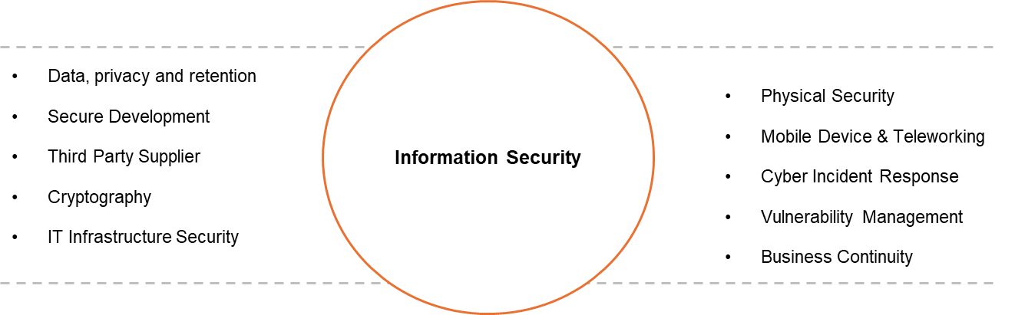
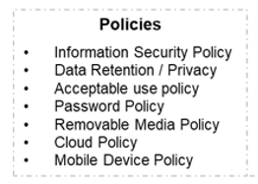
Aggreko ISO27001 – Key Standards & Policies
Information Security Standards – Based on the risk profile of Aggreko business activities, the policies and standards detailed below describe the general requirements, management arrangements, responsibilities and controls for each risk aspect. This applies to Aggreko Technology Services and should be acknowledged as part of Projects.
Standards
These Information Security Policy and Standards are mandatory within Aggreko Technology Services. Where services contracts prevent the effective application of any requirements in the Information Security Standards, this must first be reviewed by Information Security Team, who will agree with the suitability signed off by the relevant Senior Leadership Team. This should be then raised as a risk or non-conformance to a standard.
Each standard shall be defined according to the risk aspect, with consideration for: People and Processes In addition, each standard will detail Objective, Scope and Legal & Other Requirements.

Slide 27
Aggreko ISO27001 – Project Closure Checklist
As part of the ISO27001 project processes and framework, the following project closure checklist should be adopted to ensure that we have met all policies, requirements, and standards. This is detailed below:
Project Closure
Activity | Status | Comments | Sign off
Business case |  | Ensure business case is documented
Stakeholder Analysis |  | Document Stakeholder Analysis
Request for purchase & security requirements |  | Any request for purchase and supplier documentation is in place
Security, PIA & Risk Assessments |  | All security and risk assessments are documented, agreed and signed off at project kick off and project closure stages
Architecture documentation |  | Ensure this is documented.
Project & Test Plans |  | Ensure all project and test plans assoicated with security are documented e.g. Access Management.
Service Transition plan |  | Details of Work Instructions / Security Incident Management etc.
Risk transfer / Non-Conformities |  | Ensure all project risks are transferred to Information Security / Service Owners and that risks / non-conformities are raised.
Lessons Learned |  | Project processes / enhancements for Information Security & Service Transition

Slide 28
Questions

Slide 29
Appendices

